Slide 1
Roads away from home
Ages
3-6
Use these series of photos to explore different locations and how the road features may differ from the ones children may be used to.

Slide 2
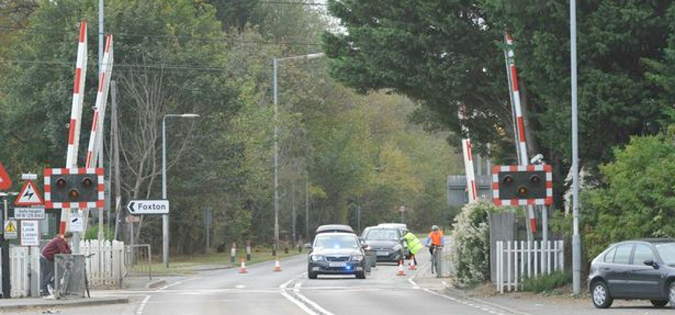
Level crossings
Notes:
As pedestrians we need to:
Concentrate – it’s easy to get distracted, especially by phones, music and conversation
Stop, look and listen. Follow signs and instructions
Check both ways before crossing – if there is a train coming, don’t cross
We must not cross until the barriers are fully raised – there may be more than one train.
Cross quickly, holding hands with an adult
Some crossings are ‘open’ and don’t have barriers, some have
a ‘full barrier’ which blocks the entire road, whilst others have a
‘half barrier.’
For more information visit: https://www.networkrail.co.uk/communities/safety-in-the-community/level-crossing-safety/pedestrian/

Slide 3
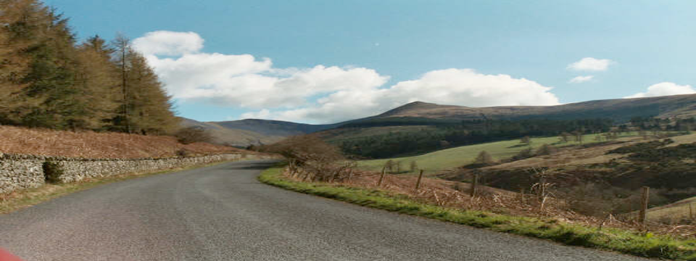
Rural roads
Notes:
The number of pedestrian accidents is higher in urban areas. However, the issue is no less serious in rural areas - rural roads are narrow and often have no pavement or crossing facilities.
As a pedestrian, by walking in the direction of oncoming traffic (as recommended by the Highway Code) you are more likely to see the danger and take avoiding action by moving out of the way.
Always find a safe place to cross that is not on a band/corner, so that you can see any vehicles coming from both directions
For more info visit: https://www.rospa.com/road-safety/advice/road-users/rural/

Slide 4
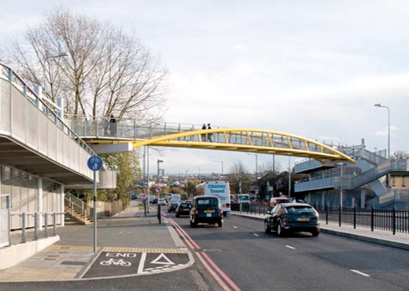
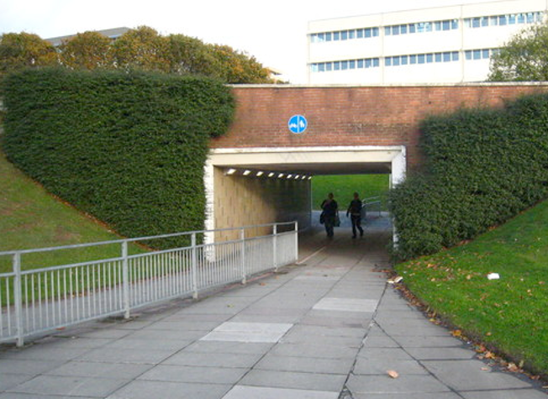
Footbridges & subways
Notes:
Footbridges go over roads and subways go under roads

Slide 5
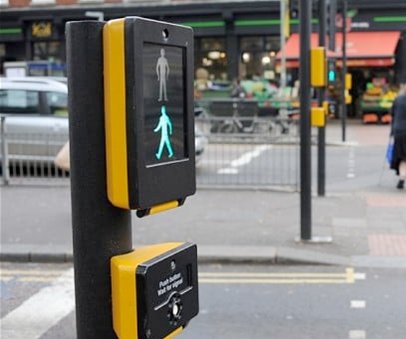
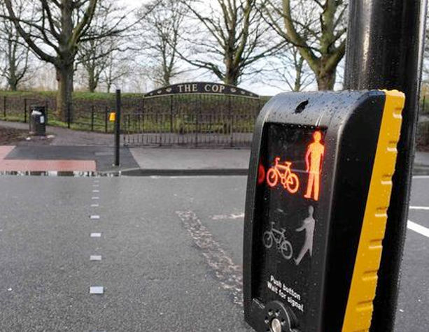
Safer places to cross
Puffin crossing
Toucan crossing
Notes:
Find safest places to cross the road
If you can, use: puffin crossings, toucan crossings, traffic islands, zebra crossings, footbridges and subways (see p7–8)
Cross where you can see clearly in all directions
Avoid crossing between parked cars if there is a safer place nearby (and be considerate yourself when parking)
Show your child how to STOP, LOOK and LISTEN

Slide 6
Stop
Look
Cars
Pedestrians
Listen
Think
Traffic light
Pavement
Notes:
Use as part of Lesson ‘1. Stepping stones to road safety’ as the key word display

