Slide 1




Hazard spotting
Ages
3-6
Look at each location shown, can you spot the great road safety behaviour, and potential hazards?
Great road safety behaviour = green arrow
Potential hazards = red arrow
Notes:
The slides show three different road scenes, each one is repeated. The first time, there is no good or risky behaviour highlighted, allowing children to suggest what they think.
The second time each image is shown, the great behaviour or potential hazards are shown using the arrows above.
If you need to explain what a ‘hazard’ is:
Hazards = things that might be potentially dangerous

Slide 2
Hazard spotting image 1
Notes:
Spot the good behaviour (2), and any hazards (1)

Slide 3
Hazard spotting image 1
Notes:
Hazard
Vehicles – even at crossing you still need to stop, look and listen, as some drivers might not stop because they have not seen the crossing or traffic lights
Good behaviour
Holding hands with an adult and stopping away from the curb
Pressing the button at the Puffin crossing and waiting for the green man to light up

Slide 4
Hazard spotting image 2
Notes:
Spot the good behaviour (1), and any hazards (3)

Slide 5
Hazard spotting image 2
Notes:
Hazard
Dog and children running into the road
On a skateboard near the road and no helmet
Playing catch next to a road, with back to road
Good behaviour
Holding hands with an adult, with the adult road-side

Slide 6
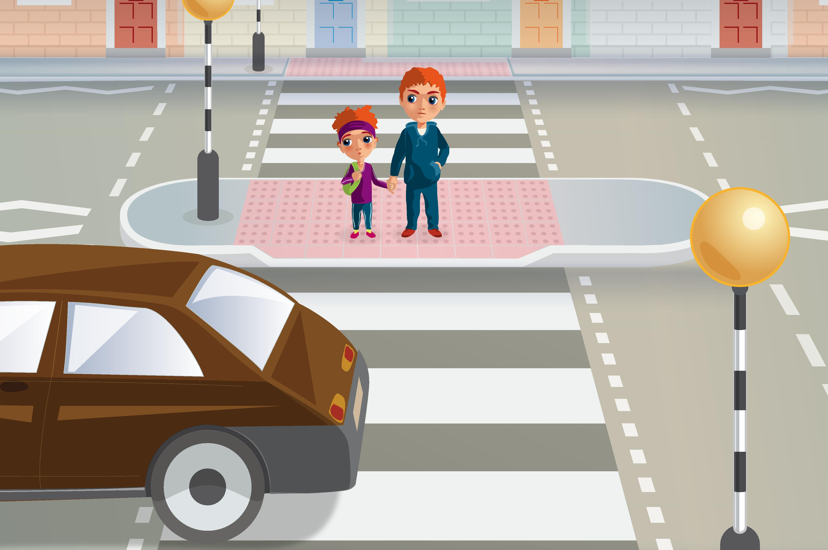
Hazard spotting image 3
Notes:
Spot the good behaviour (2), and any hazards (1)

Slide 7
Hazard spotting image 3
Notes:
Hazard
Vehicles – even at crossing you still need to stop, look and listen, as some drivers may not see the crossing or traffic lights so may not stop
Good behaviour
Holding hands with an adult and stopping away from the curb
Stop, look, listen, think at Zebra crossings and waiting for vehicles to stop before crossing

