Slide 1
Winter Drink Drive 2024 Campaign
Stakeholder Toolkit
December 2024

Slide 2
Contents
3. Strategy
4. Key Message
5. Social: Animation and static
6. Suggested Copies
7. OOH: Digital OOH, Beermats and Posters
8. Digital Audio and Radio
9. Welsh Assets
10. THINK! 0%
11. Timings and Channels
12. How to support?

Slide 3
Strategy
This year, the THINK! Drink Driving campaign aims to highlight to young men the consequences of drink driving - from losing their licence and the effect this has on their personal freedom and social life, to the risk of injuring their friends. It also challenges perceptions around personal limits, raising awareness that even a little bit of alcohol can put you and your licence at risk.
‘Drink a little. Risk a lot’ is the tagline for this year’s campaign. The creative uses eye-catching illustrations and animations that depict a personified driving licence disappearing into a pint of beer.
INSIGHT:
16 to 24 year-olds make up 24% of casualties in drink-drive collisions, while 68% of casualties involved in drink-drive collisions are male.
50% of young male drivers intend to be sensible but often get carried away while socialising, putting themselves at risk, even with a small amount of alcohol.
THINK! research shows that young drivers think about how consequences of drink driving can cause inconvenience to their everyday life and are often focused on a loss of freedom.
Research also shows that young men are most impacted by seeing how the consequences of drink driving 'ladder'—one event leading to another—rather than simply showing one isolated consequence. A combination of punitive (licence loss), physical (injury) and social (freedom, seeing friends) consequences is effective at conveying the range of risks.

Slide 4
Drink a little, Risk a lot.
Key Message

Slide 5
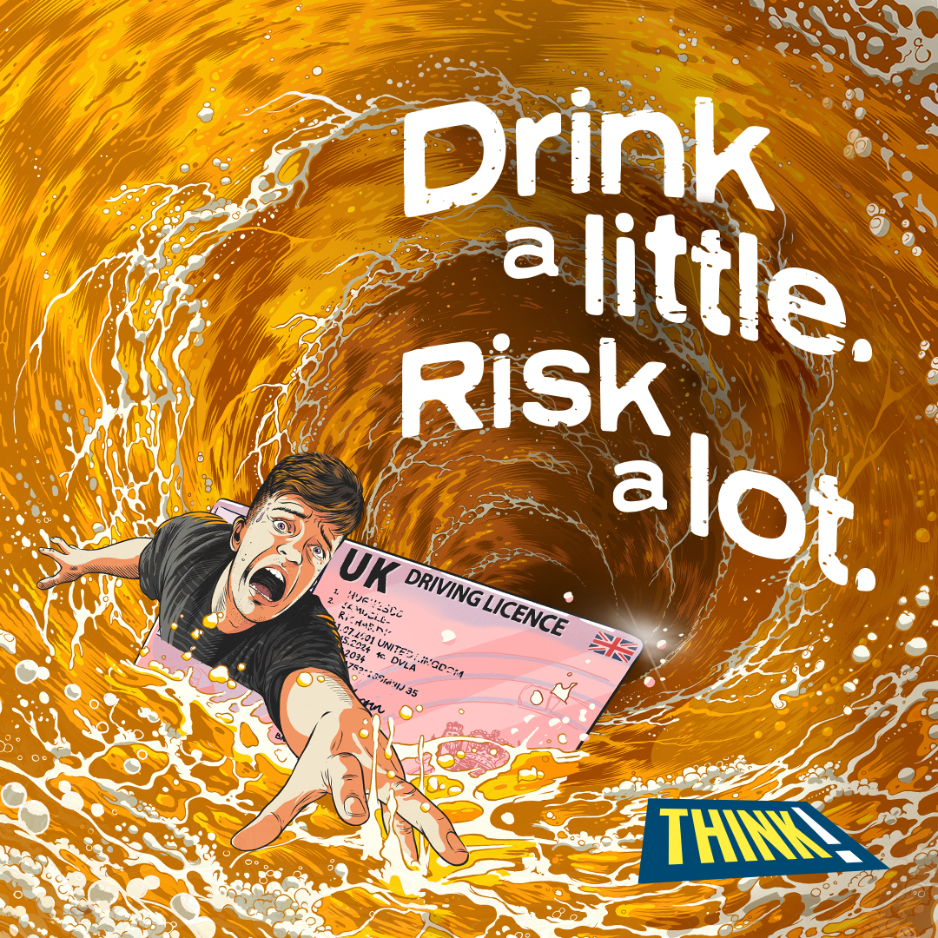
Social Animations and static
15s film – 9x16
Download here
Social static – 1x1
Download here
Our Drink a little, Risk a lot animation shows a young man and his licence being sucked into a whirlpool in a pint of beer, highlighting the risk of losing your licence if you drink drive.
THINK! will promote the assets with paid spend across Snapchat, Reddit and Facebook/Instagram as well an online video platforms such as YouTube and Twitch.
Our assets will also be posted on organic channels (please see page 12 for a media laydown and THINK! social handles).
Available assets:
Video animation:
1 x 15s (9:16, 1:1 and 16:9)
3 x 6s (9:16 and 1:1)
Social static
1 x 1:1
How to support
From 20 November, you can amplify our organic posts or download our assets from the THINK! Campaigns page and share on your own channels
Coming soon:
15s film – 16:9
15s film – 1:1
6s film – cutdown (9:16 and 1:1)
6s film – social consequences (9:16 and 1:1)
6s film – injury (9:16 and 1:1)
Notes:
Use another asset for mates for life, use copy side by side
Potentially put it another page

Slide 6
Suggested Social Copy
If you drink and drive, you risk losing your licence, injuring your mates, and everything that goes with that. #DrinkALittleRiskALot
Think you’re okay to drive after a drink? Alcohol’s effects vary with your size, age, stress levels—even what you had for dinner. Don’t risk it. #DrinkALittleRiskALot
If you drink and drive, you risk losing your licence, injuring your mates, and everything that comes with it. Alcohol hits everyone differently—your size, age, and even what you ate all play a role. Don’t chance it. #DrinkALittleRiskALot
Think about what’s at stake if you drink and drive—not just your licence, but your job and career too. #DrinkALittleRiskALot
Drinking before driving could cost you your licence and the freedom you’ve worked so hard for. Don’t chance it #DrinkALittleRiskALot
Stakeholder-facing social copy
We are/ XX is proud to be supporting @THINKgovuk to highlight the risks of drink driving – from losing your licence and the freedom that comes with it, to injuring yourself or someone else. #DrinkALittleRiskALot

Slide 7
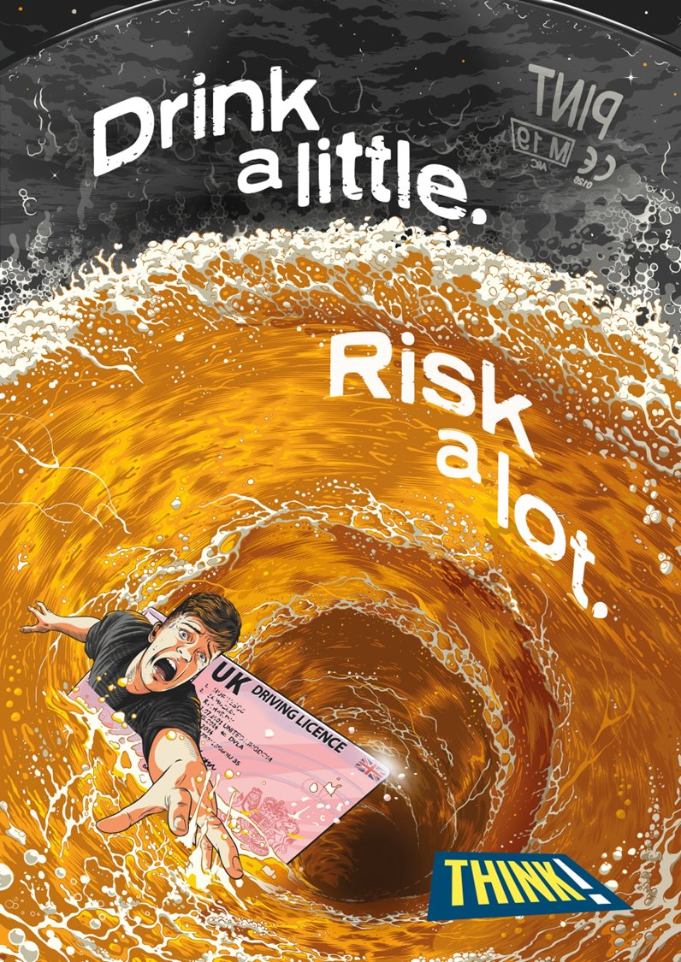
OOH Beermats, Posters and Digital OOH (D6)
Our Digital OOH will be featured on roadside digital 6 sheet poster sites within 100m of pubs and bars across England and Wales to hit audiences at the exact moment before they enter the venue.
The beermats and washroom posters will target young men in pubs and bars, encouraging them to make safer choices in the moment.
Available assets:
6-sheet (eg, bus shelters)
A4 poster
Beermats
How to support
You can play a part in championing this call to action by putting up our posters in local venues where our target audience gathers.
Please email DfTPUBLICITY@dft.gov.uk for access to the files. The Department for Transport will need to approve partner co-branded materials.

Slide 8
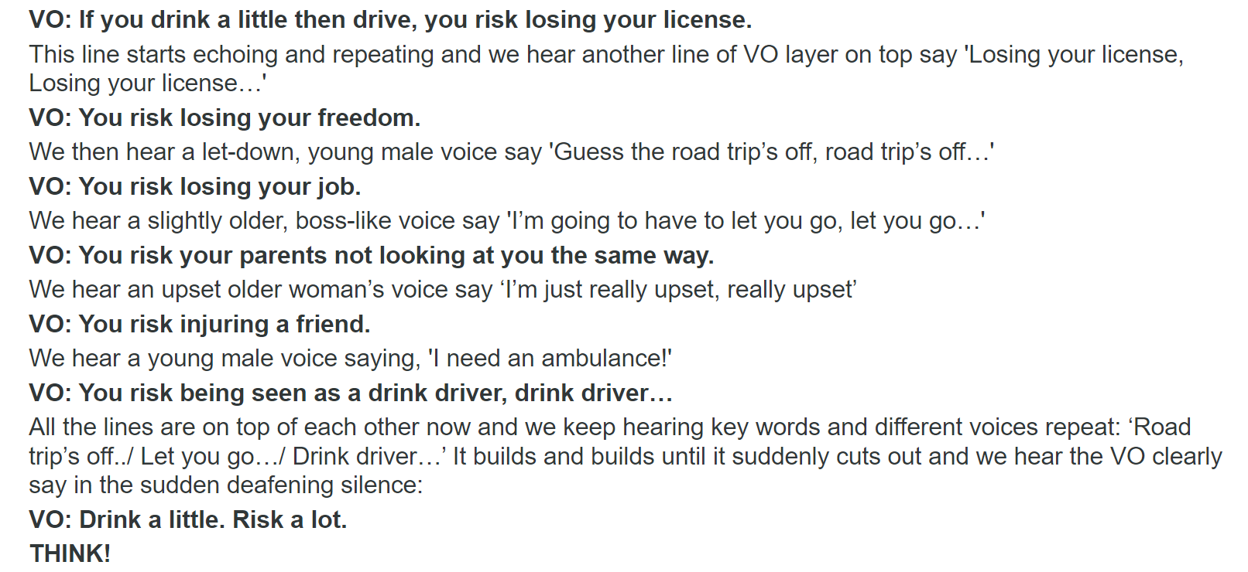
Digital Audio Radio
We have used audio within our campaign as it highly indexes against our young male audience. This approach allows us to be highly targeted and contextually relevant.
The audio will run across KISS, Capital, Radio X and TalkSPORT, digital audio channels including Kisstory, Kiss Fresh and Capital Dance, and on Spotify.
The radio script uses a laddering approach to emphasise the consequences of drink driving.
It will run from the 9 December for the final three weeks of the campaign, leading up to Christmas and New Year, when drinking occasions are at their peak.
Available assets
1 x 30 second audio advert

Slide 9
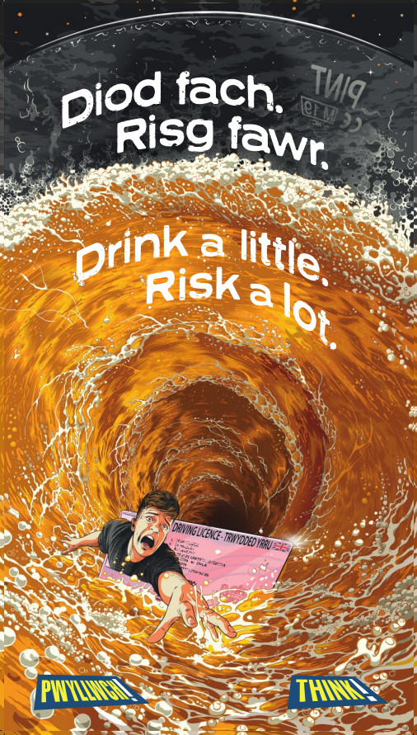
Welsh Assets
Digital out of home - bilingual
Coming soon:
Welsh language social static – 1:1
Bilingual Welsh/English out of home advertising will run exclusively on D6 screens in Wales.
We also have a Welsh-language social static available for use via partner channels.

Slide 10
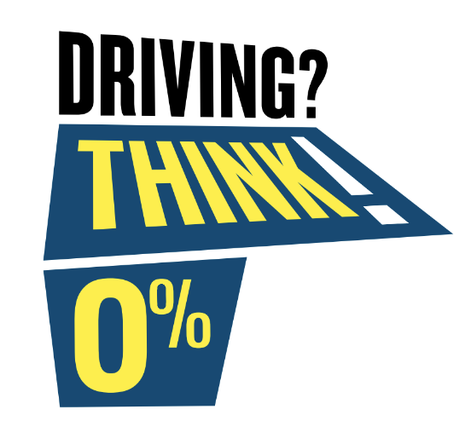
THINK! 0%
THINK! 0% is a brand new, partner-led platform that aims to encourage drivers to always opt for 0% over an alcoholic drink if they’re getting behind the wheel.
In collaboration with on and off-trade organisations. THINK! 0% aims to create a new social norm amongst drivers. Together, we will prompt them to THINK! 0% when in drinking environments and help them to set new, safer habits without missing out on good times
We have developed the THINK! 0% badge. This is designed to be used on partners’ marketing materials to highlight a safe drinking option to drivers and divert them away from risky behaviours.
How to support:
Co-creating content
Integrating the THINK! 0% badge within your marketing materials
Using THINK! 0% assets in your comms
Download 0% assets here:
*Please do not share with anyone under the legal age for drinking.

Slide 11
Timings and Channels
Media Laydown: Timings and Channels
Activity | Week Commencing
 | 18 Nov | 25 Nov | 2 Dec | 9 Dec | 16 Dec | 23 Dec | 31 Dec
THINK! 0% Launch | From 20 Nov
Out-of-home | From 18 Nov
Digital Audio | From 18 Nov
THINK! organic social Twitter / X, Facebook, Instagram | From 20 Nov
PR activity | From 20 Nov
Paid social Snapchat, Reddit and Meta |  |  | From 4 Dec
Online Video |  |  | From 4 Dec
Radio |  |  |  | From 9 Dec

Slide 12
How to support?
AMPLIFICATION
There are many ways to support our campaign! Help us amplify the message by sharing our content on your social media channels —see page 5 for suggested copy to make it easy.
You can follow and tag us here:
X: @THINKgovuk
Instagram: @thinkdriver
You can also download our campaign materials directly from the campaign page on our website and share them across your platforms. Please get in touch if there are opportunities to co-brand or work together to make campaign materials relevant to your channels and area.
If you're interested in requesting physical campaign materials, please reach out to us at DfTPUBLICITY@dft.gov.uk.
EVALUATION
How did the assets perform?
Please drop DfTPUBLICITY@dft.gov.uk an email and let us know how the assets performed for you across your own channels to help with our post-campaign evaluation.

Slide 13
Thank you

